Slide 1
Shared Class Notebook
Vincent Mac and Nicholas Chin
CSE 111-01, Professor Rusu

Slide 2
System Description
Database that allows students and their professors to add, update, and view each others notes within their respective classes.
Using a standard SQLite3 database and accessing with javascript (node.js module)

Slide 3
Implementation Details
Integrated Development Environment (IDE)
Microsoft Visual Studio Code
Database
SQLite3 Database
Language
SQLite3
HTML
CSS
Javascript (nodejs)

Slide 4
Important Use Cases
Students
Method of accessing note folders for your classes made by your professor
Ability to see folders of all of your registered classes
View and upload notes from your peers or professor
Professor
Add/Remove students ability to view their class
Ability to upload and edit class notes or documents for viewing
Act as the administrator for their class database

Slide 5
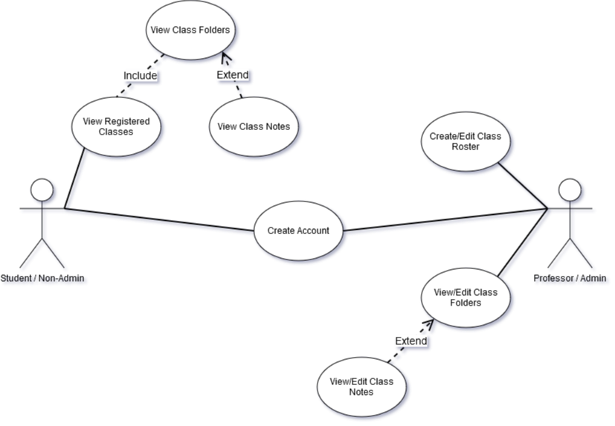
Use Case Diagram

Slide 6
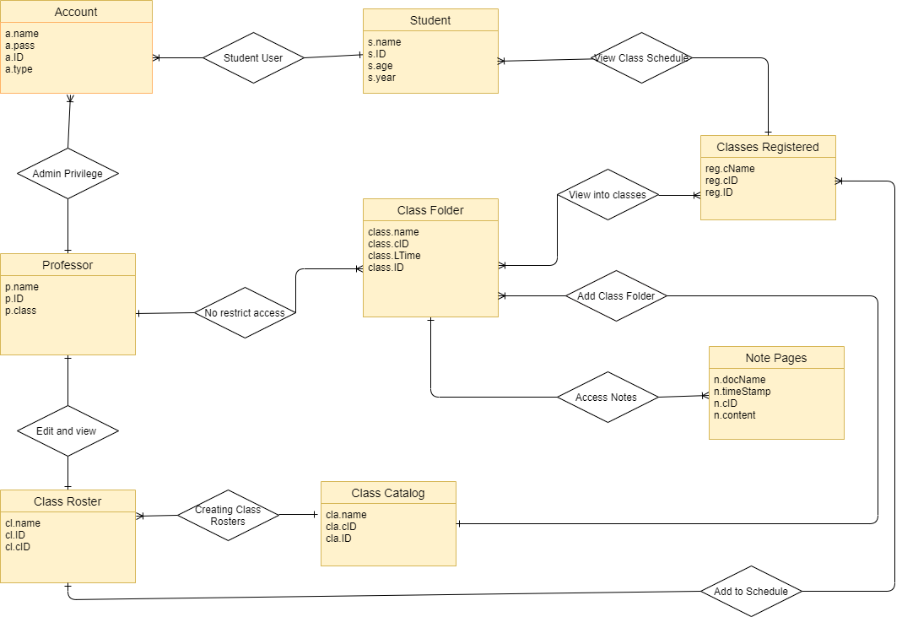
E/R Diagram

Slide 7
Relational Schema
CLASSES REGISTERED
reg_cName varchar(50)
reg_cID Unsigned int
reg_ID Unsigned int
CLASS FOLDER
class_name varchar(50)
class_cID Unsigned int
class_LTime text
class_ID Unsigned int
NOTE PAGES
n_docName varchar(50)
n_timeStamp text
n_cID Unsigned int
n_content text
ACCOUNT
a_name varchar(50)
a_pass varchar(50)
a_ID Unsigned int
a_type varchar(10)
STUDENT
s_name varchar(50)
s_ID Unsigned int
s_age Unsigned int
s_year Unsigned int
PROFESSOR
p_name varchar(50)
p_ID Unsigned int
P_class varchar(50)
CLASS ROSTER
Cl_name varchar(50)
cl_ID Unsigned int
cl_cID Unsigned int
CLASS CATALOG
cla_name varchar(50)
cla_ID Unsigned int
cla_cID Unsigned int

